Slide 1
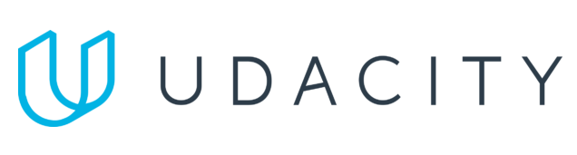
Data Lake Value Proposition
Medical Data Processing Company
Thu Huynh
Udacity IPS Version 1.0

Slide 2
Agenda
What is a Data Lake
Components of a Data Lake
Data Lake vs Data Warehouse
Business Value of Data Lake Solution
Proposed Data Lake Architecture for Medical Data Processing system
Udacity IPS Ver. 1 2/2020

Slide 3
What is a Data Lake
Executive summary
A data lake is a centralized repository that allows to store all structured and unstructured data at any scale. You can store your data as-is (without having to first structure the data), and run different types of analytics—from dashboards and visualizations to big data processing, real-time analytics, and machine learning to guide better decisions.

Slide 4
Components of Data Lake
Ingestion layer: for ingesting real-time data, or batch data and CDC
Storage layer: for storage of raw, staging data and transformed data, or any other file format
Processing layer: for processing and transforming data
Serving layer: for serving raw, streaming and transformed data to dashboards, web/app interfaces, and APIs

Slide 5
Data Warehouse
Data Lake
Relational from transactional systems, operational databases, and line of business applications
Designed prior to the DW implementation (schema-on-write)
Fastest query results using higher cost storage
Highly curated data that serves as the central version of the truth
Batch reporting, BI and visualizations
Non-relational and relational from IoT devices, web sites, mobile apps, social media, and corporate applications
Written at the time of analysis (schema-on-read)
Query results getting faster using low-cost storage
Any data that may or may not be curated (ie. raw data)
Machine Learning, Predictive analytics, data discovery and profiling
Udacity IPS Ver. 1 2/2020

Slide 6
Business Value of Data Lake
A data lake is the most recommended for Medical Data Processing Company for these reasons:
The data lake can ingest, store and process all kinds of data format: from structured to unstructured
Cheaper costs
A data lake will support better for different business requirements: analytical and operational use cases, serve real-time data for web interfaces, …
A data lake will help to keep all data at one place while separate different sources as mentioned in the requirements
Offers a reliable, fault-tolerant & highly scalable data storage & processing solution

Slide 7
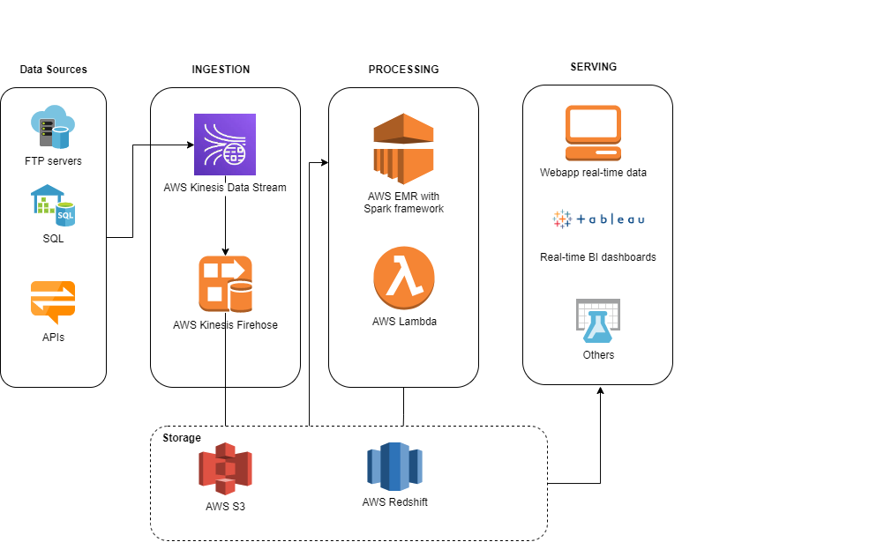
Data Lake Architecture

Slide 8
THANK YOU
Udacity IPS Version 1.0

